Slide 1

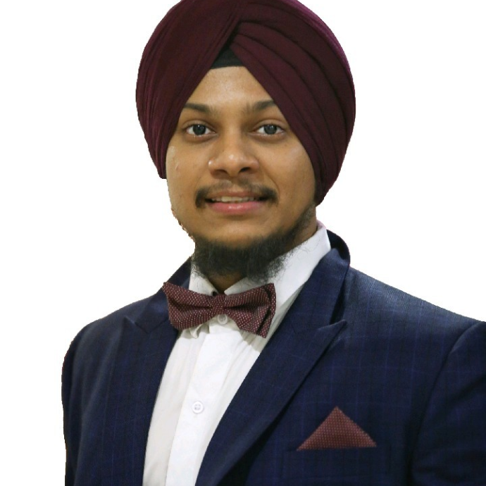

Arun Siddappa Shetty
Manjit Singh Arora
Accenture Technology Centre
Cloud Transformation & Migration Senior Analyst
IPS Oracle CX
Accenture India
MDC2B, Plant 3 Godrej & Boyce Complex, Vikhroli, Mumbai
Phone: +91 809 776 5855
manjit.singh.arora@accenture.com
Professional experience
Functional/Technical
Omnichannel Architectures (B2C/B2B)
Solution / Enterprise Architecture
Agile and Scrum methodology
Data Modelling, APIs & Microservices
Certifications
Oracle Industry Solution (DX4C)
Oracle CX (Service, Sales and Field Service)
Oracle Commerce Cloud
Industry
Telco B2C/ B2B
H&PS
Utilities
Technologies
API & Mise: Spring, Node Js
Web Apps: Angular, J2ee, React
DBs: Oracle, Mongo
PaaS: AWS, VBCS
SaaS: Oracle CX / DX4C
Professional background
Manjit Singh is a Cloud Trans & Mig Senior Analyst in ATC India for IPS Oracle CX.
With more than 6 years of experience as Senior Cloud Implementation Expert he has delivered multiple cloud implementation project by playing a key role of an SME and leading the team, specialized in multiple domains including CMT, Insurance, Utilities, H&PS.
Manjit is an extremely organized person with the ability to work/lead both independently of his own initiative or as part of a team.
Passionate about Innovation, Technology, Culture, People, Sustainability, Astrophile and Sports. A fitness enthusiast, cinema buff, avid traveler and melophile.
Remarkable Achievements
I have received Accenture Celebrates Excellence Awards (ACE) - Client & Customer - FY20 Q2 for the contributions that help Accenture consistently deliver value to our Clients, People and our Organization.
I have received Apex Awards Fiscal FY20 Q1,Q2 (Team Award Delivery & Profitability) for contributing to successful delivery and higher contract profitability and making an impact on the client value creation.
Received many recognition and appreciations from my peers, supervisors, managers and leadership during my tenure in Accenture.
Contributed to Client Co Innovation, Capability and Asset Extraction.
Relevant Project Experience (extract)
Module lead – DX4C Buying X
End to end responsibility to design and deliver the storefront use case of DX4C BuyingX offering which includes preparation of an api collection according to the business requirement.
Contributing TMF & Accenture collaboration, to prepare multichannel use cases around DX4C BuyingX, DX4C CareX and Commerce cloud application.
Senior Developer for Telco Client, USA
I have worked with Onshore and Client on solutioning of complex Use Cases and developing assets to create business for the Client using innovation and automation.
Worked on the assessment and delivery of the solution for the client which includes migration of all the data from Oracle Service Cloud and Sales Cloud to a data lake system.
Asset Development – MVP for DX4C
Preparing MVP solution that will help Client On-Premise application to configure their target environment in an automated way with very minimal manual intervention.
Ensuring performance, stability, agility and security of the asset before it being deployed to the client environment.
CX SME
Working as technical lead and delivering for integration, data mapping, customization CPMs, workflows, reports and BUI extensions to implement business requirement. Integration with multiple system for scheduling and managing information.
Working as a Cloud Implementation Senior Developer Leading development teams for the integration of Oracle Commerce solution into the BSS client landscape for the B2C market.

